Slide 1
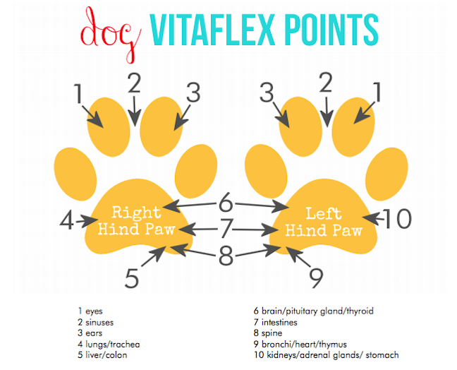
ESSENTIALOILWORKS.COM

